Slide 1
Digital Logic Design
Thomas L. Floyd 9th Edition
Chapter 7
Daw Khin Ohnmar Maung
Lecturer, CEIT

Slide 2
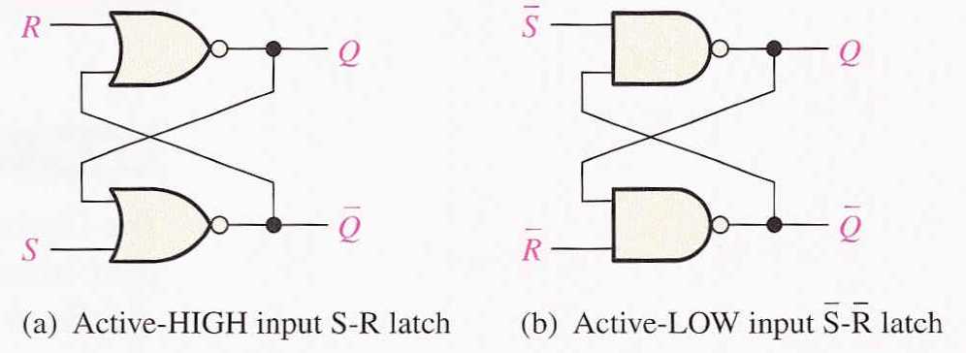
Latches
A latch is a temporary storage device that has two stable states (bistable). It is a basic form of memory.
The S-R (Set-Reset) latch is the most basic type. It can be constructed from NOR gates or NAND gates. With NOR gates, the latch responds to active-HIGH inputs; with NAND gates, it responds to active-LOW inputs.

Slide 3
The active-HIGH S-R latch is in a stable (latched) condition when both inputs are LOW.
Assume the latch is initially RESET (Q = 0) and the inputs are at their inactive level (0). To SET the latch (Q = 1), a momentary HIGH signal is applied to the S input while the R remains LOW.
0
R
1
0
Q
Latch initially RESET
0
1
Q
0
S
0
R
0
To RESET the latch (Q = 0), a momentary HIGH signal is applied to the R input while the S remains LOW.
1
Q
Latch initially SET
1
0
Q
0
S

Slide 4
The active-LOW S-R latch is in a stable (latched) condition when both inputs are HIGH.
Assume the latch is initially RESET (Q = 0) and the inputs are at their inactive level (1). To SET the latch (Q = 1), a momentary LOW signal is applied to the S input while the R remains HIGH.
1
S
1
0
Q
Latch initially RESET
0
1
R
1
Q
1
S
0
To RESET the latch a momentary LOW is applied to the R input while S is HIGH.
1
Q
Latch initially SET
1
0
1
Q
R

Slide 5
Normal Operation: When Q is HIGH, Q is LOW, and when Q is LOW, Q is HIGH
Invalid Condition:
- LOWs are applied to both S and R at the same time

Slide 6
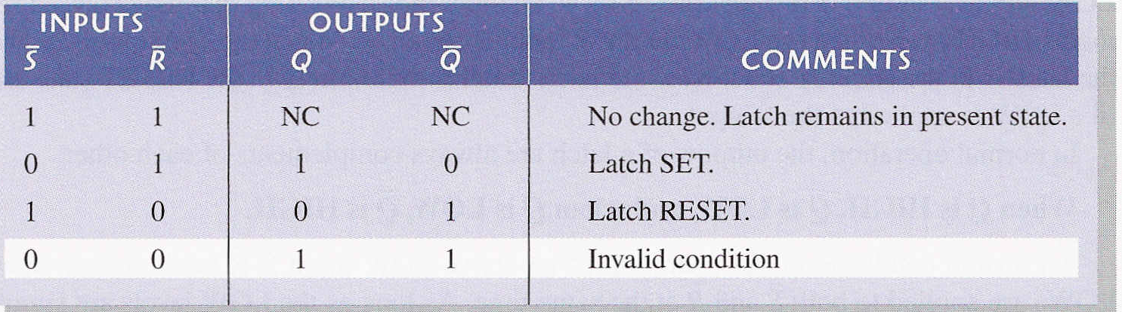
Truth table for an active-LOW input S-R latch

Slide 7
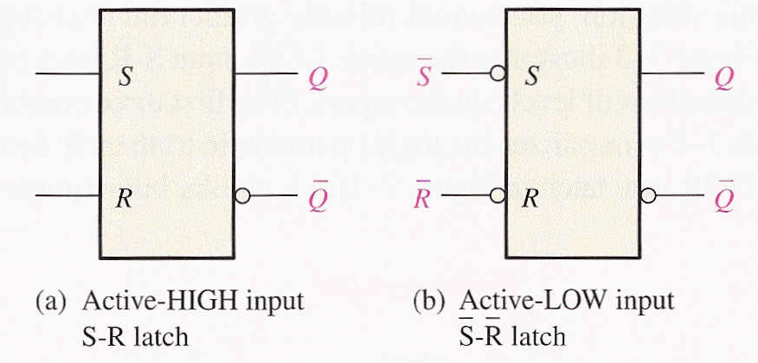
Logic symbols for the S-R and S-R latch

Slide 8
A gated latch is a variation on the basic latch.
The gated latch has an additional input, called enable (EN) that must be HIGH in order for the latch to respond to the S and R inputs.
S
Q
EN
Show the Q output with relation to the input signals. Assume Q starts LOW.
Example
Q
R
Solution
Keep in mind that S and R are only active when EN is HIGH.
S
R
EN
Q

Slide 9
The D latch is an variation of the S-R latch but combines the S and R inputs into a single D input as shown:
D
D
Q
Q
EN
EN
Q
Q
A simple rule for the D latch is:
Q follows D when the Enable is active.

Slide 10
The truth table for the D latch summarizes its operation. If EN is LOW, then there is no change in the output and it is latched.

Slide 11
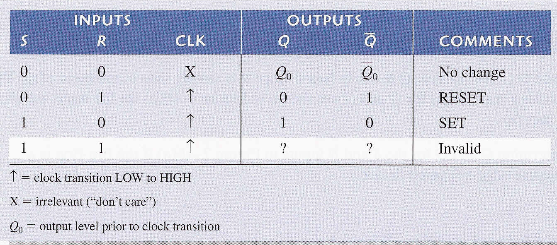
Edge-Trigger S-R Flip-Flop
S and R inputs of the S-R flip-flop are called synchronous inputs
Data on these inputs are transferred to the flip-flop’s output only on the triggering edge of the clock pulse
Flip-Flop cannot change state except on the triggering edge of a clock pulse

Slide 12
Edge-Triggered D Flip-Flop
A flip-flop differs from a latch in the manner it changes states. A flip-flop is a clocked device, in which only the clock edge determines when a new bit is entered.
The active edge can be positive or negative.
Dynamic input indicator

Slide 13
The truth table for a positive-edge triggered D flip-flop shows an up arrow to remind you that it is sensitive to its D input only on the rising edge of the clock; otherwise it is latched.
The truth table for a negative-edge triggered D flip-flop is identical except for the direction of the arrow.
(a) Positive-edge triggered (b) Negative-edge triggered

Slide 14
Edge-Triggered J-K Flip-Flop
The J-K flip-flop is more versatile than the D flip flop. In addition to the clock input, it has two inputs, labeled J and K. When both J and K = 1, the output changes states (toggles) on the active clock edge (in this case, the rising edge).

Slide 15
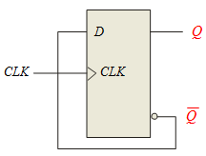
Note
D-flip-flop does not have a toggle mode like the J-K flip-flop
you can hardwire a toggle mode by connecting Q back to D as shown
useful in some counters

Slide 16
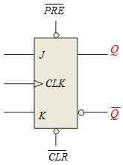
Asynchronous Preset and Clear
Most flip-flops have other inputs that are asynchronous, meaning they affect the output independent of the clock
Two such inputs are normally labeled preset (PRE) and clear (CLR).
These inputs are usually active LOW.
J-K flip flop with active LOW preset and clear is shown.

Slide 17
Example
PRE
Determine the Q output for the J-K flip-flop, given the inputs shown.
Q
J
CLK
K
Q
Solution
CLR
Set
Toggle
Set
Reset
Toggle
Latch
CLK
J
K
Set
PRE
Reset
CLR
Q

Slide 18
Flip-flop Operating Characteristics
Propagation delay time is specified for the rising and falling outputs. It is measured between the 50% level of the clock to the 50% level of the output transition.
50% point on triggering edge
CLK
CLK
50% point
Q
50% point on LOW-to-HIGH transition of Q
Q
50% point on HIGH-to- LOW transition of Q
t_{PLH}
t_{PHL}

Slide 19
Another propagation delay time specification is the time required for an asynchronous input to cause a change in the output.
PRE
50% point
CLR
50% point
Q
50% point
Q
50% point
t_{PHL}
t_{PLH}

Slide 20
Set-up time and hold time are times required before and after the clock transition that data must be present to be reliably clocked into the flip-flop.
Setup time is the minimum time for the data to be present before the clock.
D
CLK
Set-up time, t_{s}
Hold time is the minimum time for the data to remain after the clock.
D
CLK
Hold time, t_{H}

